Slide 1

eniac
INFORMÁTICA

Slide 2
Revenue & discounts
Business questions:
Is product discount more beneficial to the company’s growth than improved product quality?
How do high and low product discounts affect the company’s total revenue?

Slide 3
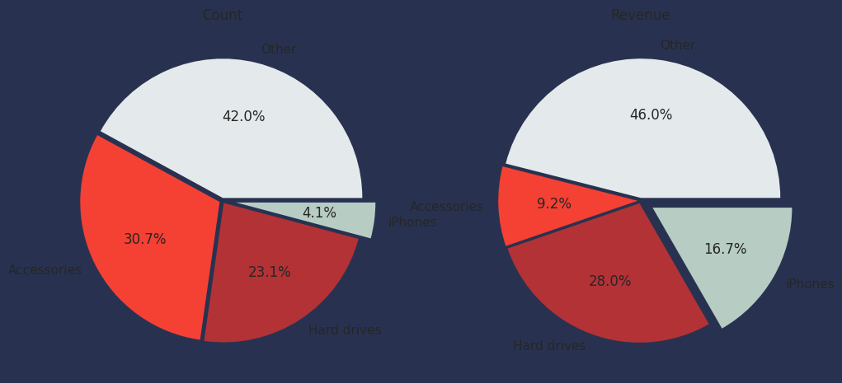
Eniac’s products categories
other
iPhones
accessories
hard drives
Sales

Slide 4
Eniac’s products categories
other
other
accessories
iPhones
accessories
iPhones
hard drives
hard drives
Sales
Revenue

Slide 5
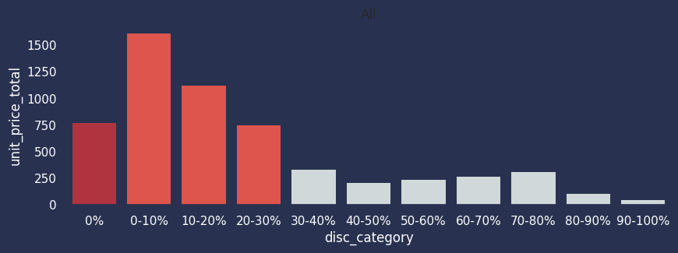
Revenue per discount range

Slide 6
Revenue per discount range
Up to 30% discount is beneficial

Slide 7
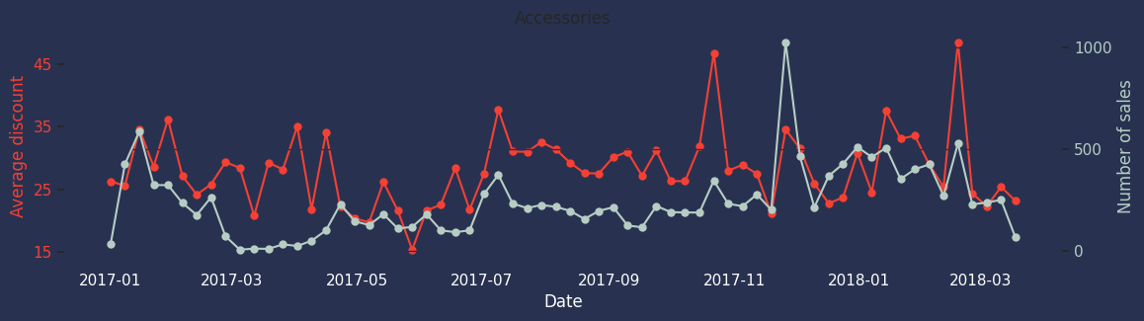
Average discounts vs N of sales

Slide 8
Average discounts vs N of sales
r~0.5
HARD DRIVES
r~0.4
ACCESSORIES
r~0.01
Apple

Slide 9
Are discounts effective?
Overall, products sold with small discounts (0-30%) are currently the most profitable
Products with a strong brand perception (Apple products) are sold regardless of discounts → Discount not recommended
Lower-priced items (hard drives, accessories) benefit from discounts → Discount recommended

Slide 10
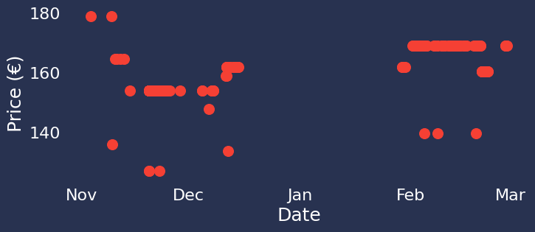
Better data collection → Better recommendations
How to improve data collection on discounts:
Step 1: Monitor discounts independent of orders
→ Continuous monitoring rather than snapshots when an order is made

Slide 11
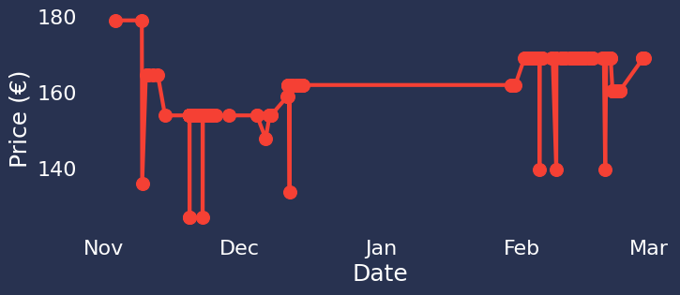
Better data collection → Better recommendations
How to improve data collection on discounts:
Step 1: Monitor discounts independent of orders
→ Continuous monitoring rather than snapshots when an order is made

Slide 12
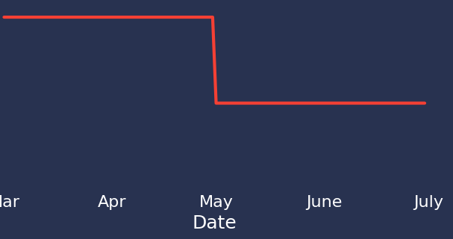
Better data collection → Better recommendations
How to improve data collection on discounts:
Step 1: Monitor discounts independent of orders
→ Continuous monitoring rather than snapshots when an order is made
Step 2: Perform systematic testing
→ Offer products at different discounts for set time periods
→ e.g. 0% vs. 20% for two months each

Slide 13




Thank you for your attention!
Notes:
:D:D:D

